Slide 1
Forced Entry and Ballistic Resistant Louver Design and Optimization with Associated Storm Shutter
MAE 3195 Final Presentation
Spring 2013
Benjamin Yarmis

Slide 2
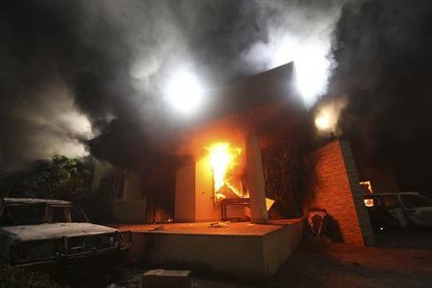
Introduction
US diplomatic mission in Benghazi, Libya was attacked September 11, 2012
RPGs, assault rifles, 14.5mm anti-aircraft machine guns
4 fatalities, 10 injuries
Some due to smoke inhalation
FEBR louvers protect passages to sensitive areas that require airflow
HVAC
Not the only famous example of an exposed HVAC vent

Slide 3

Introduction

Slide 4
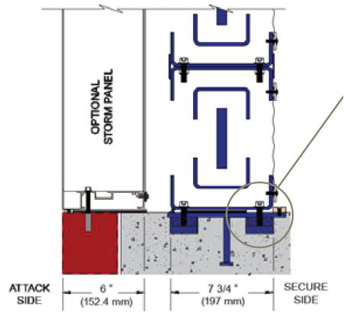
Introduction
Design and optimize an FEBR louver to withstand 3 loading conditions
Impact of a 9mm bullet
1000 psi static force
1000 psi sinusoidal force
Design a storm shutter to protect louver from rain

Slide 5
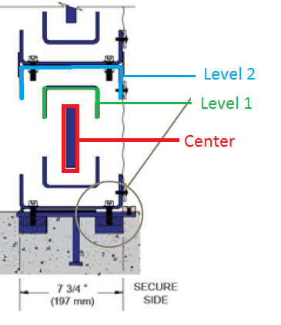
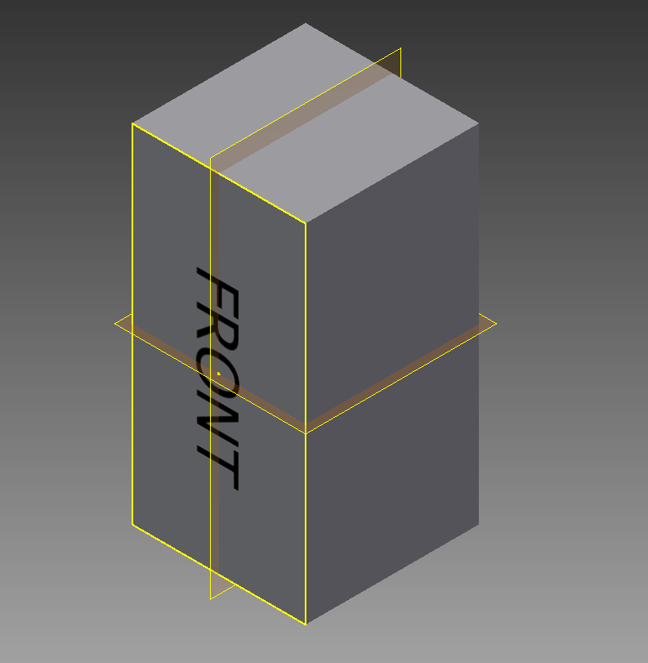
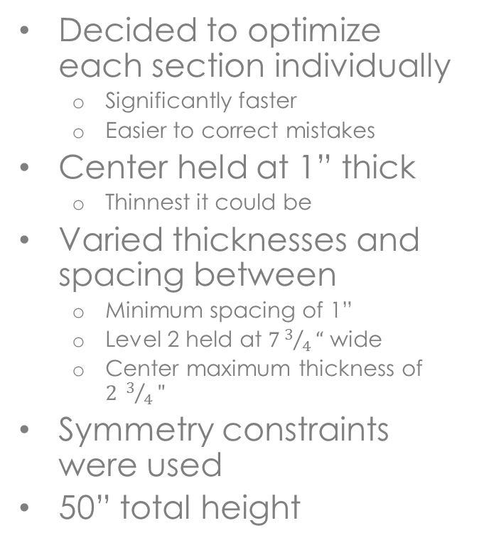
FEBR Louver Parametric Design
Decided to optimize each section individually
Significantly faster
Easier to correct mistakes
Center held at 1” thick
Thinnest it could be
Varied thicknesses and spacing between
Minimum spacing of 1”
Level 2 held at $73/4“$ wide
Center maximum thickness of $2 3/4"$
Symmetry constraints were used
50” total height

Slide 6
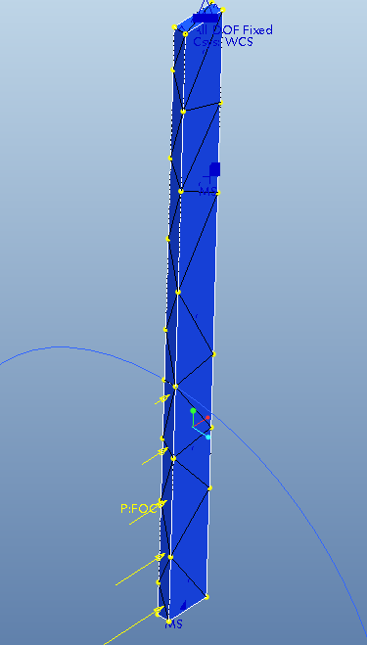
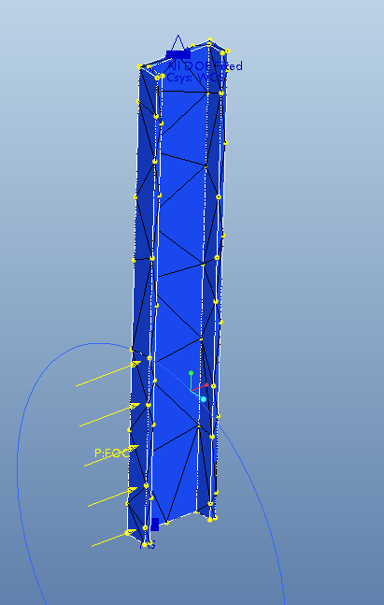
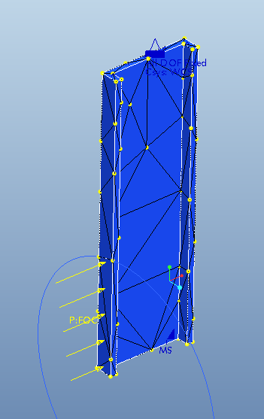
Finite Element Model
Center
44 Elements
Level 1
131 Elements
Level 2
110 Elements

Slide 7
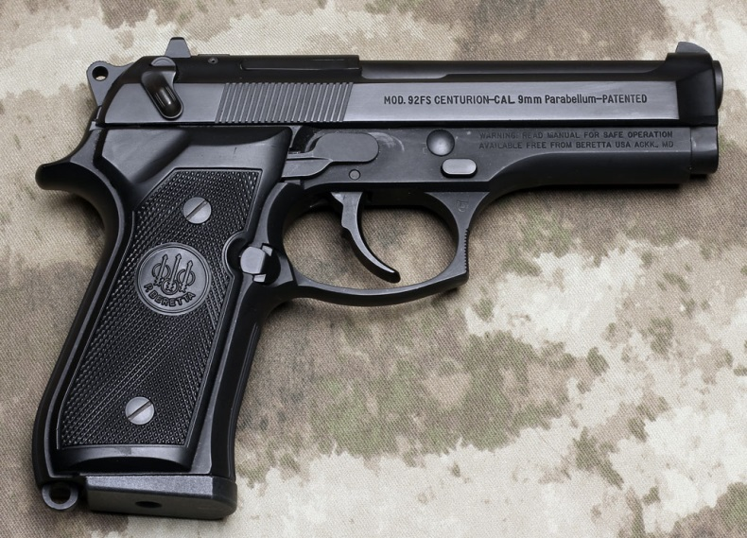
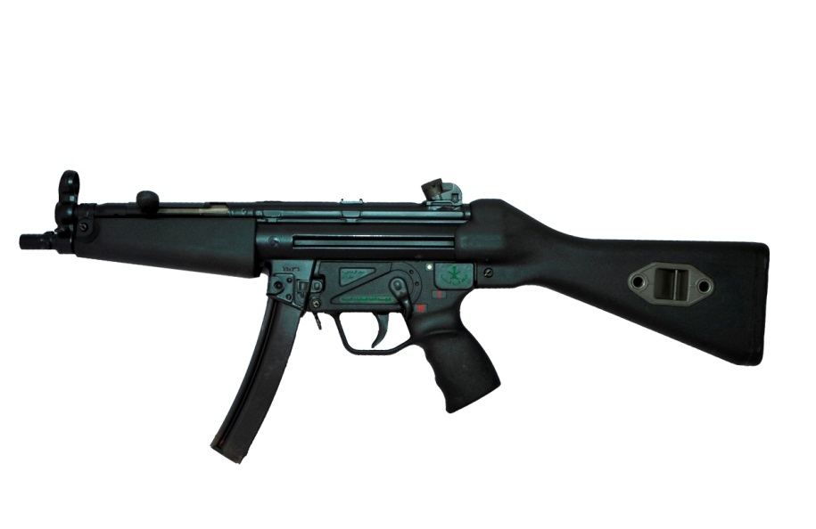
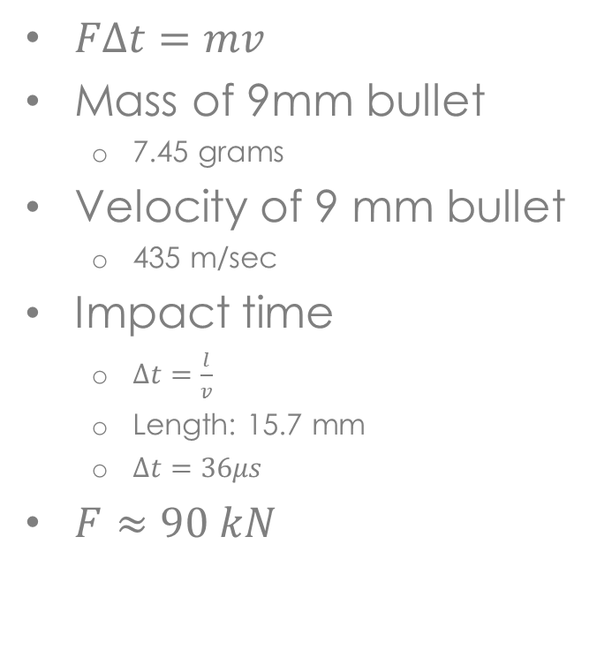
Loads– 9mm Bullet
$FΔt=mv$
Mass of 9mm bullet
7.45 grams
Velocity of 9 mm bullet
435 m/sec
Impact time
$Δt=\frac{l}{v}$
Length: 15.7 mm
$Δt=36μs$
$F≈90 kN$

Slide 8
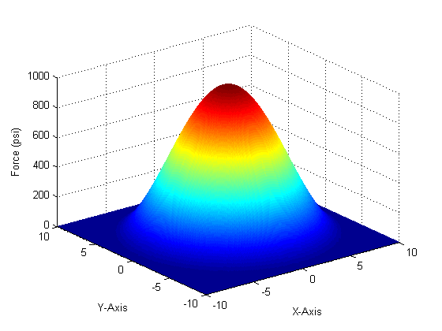
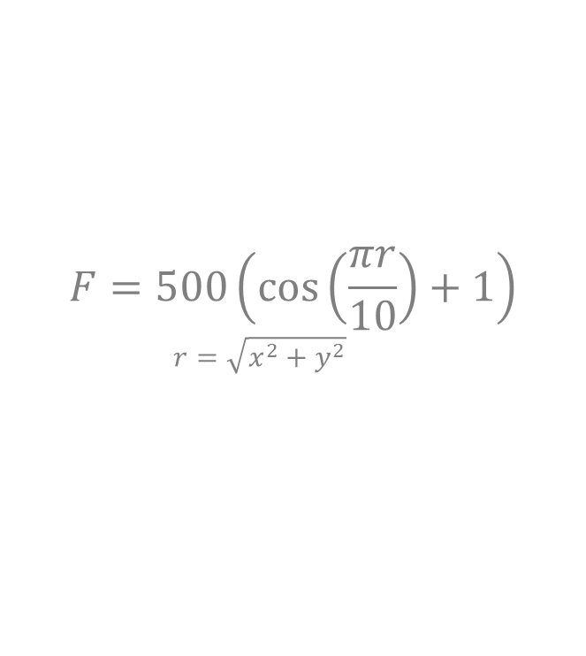
Loads– Sinusoidal Force
$$F=500\left(\cos\left(\frac{πr}{10}\right)+1\right)$$
$$r=\sqrt{x^{2}+y^{2}}$$

Slide 9
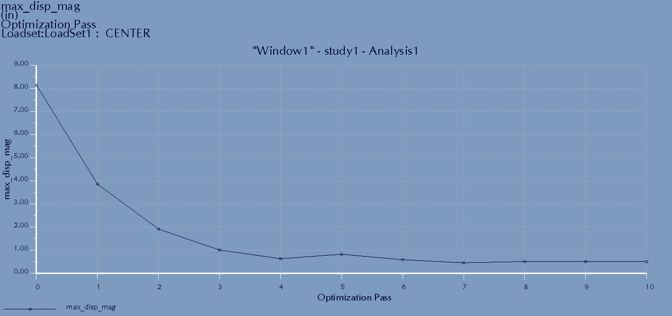
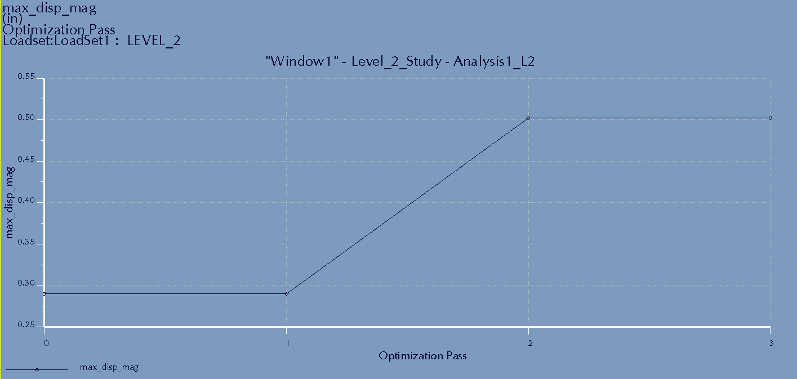
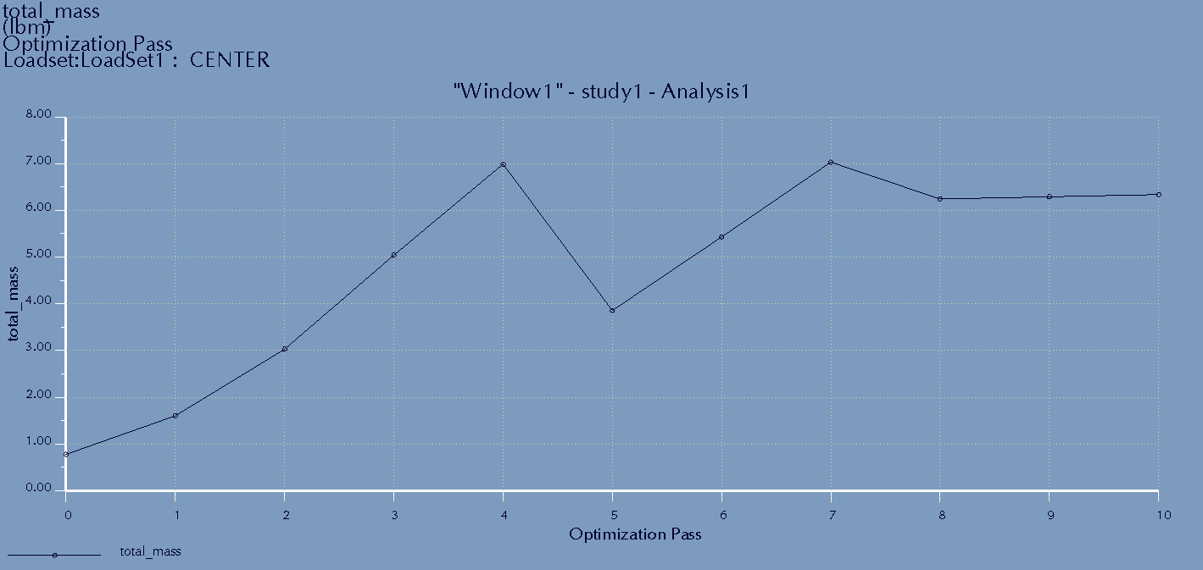
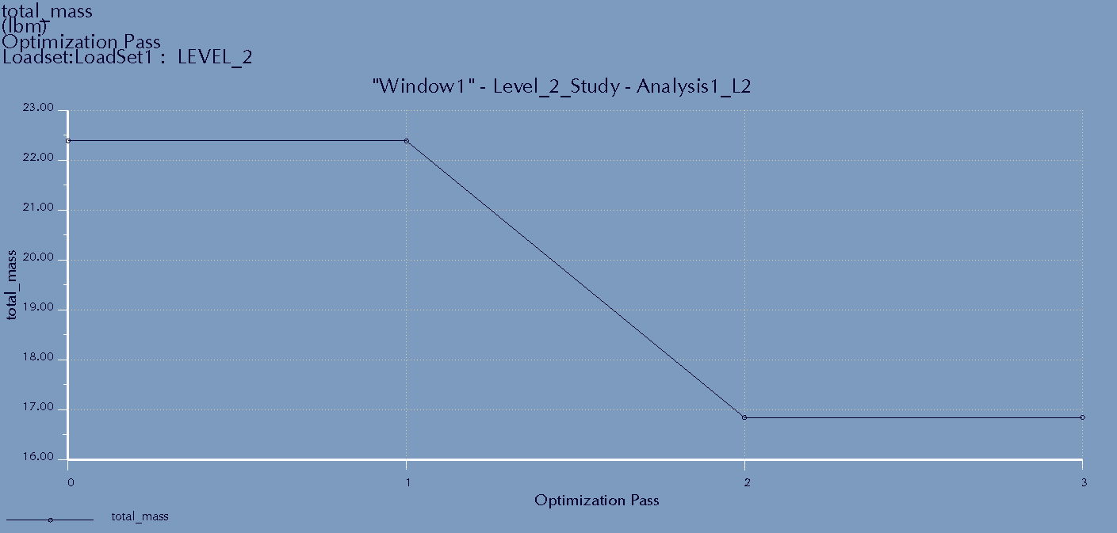
Convergence– Bullet Load
Center
Level 1
Level 2
Displacement (Top)
Mass (Bottom)

Slide 10
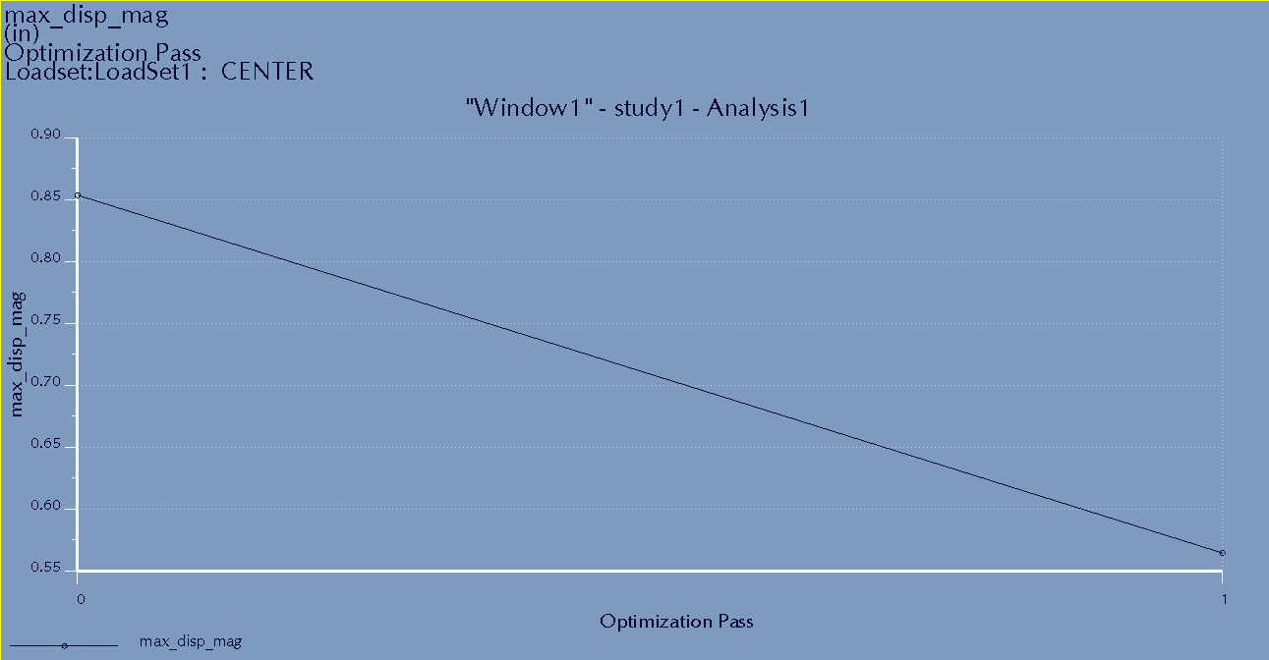
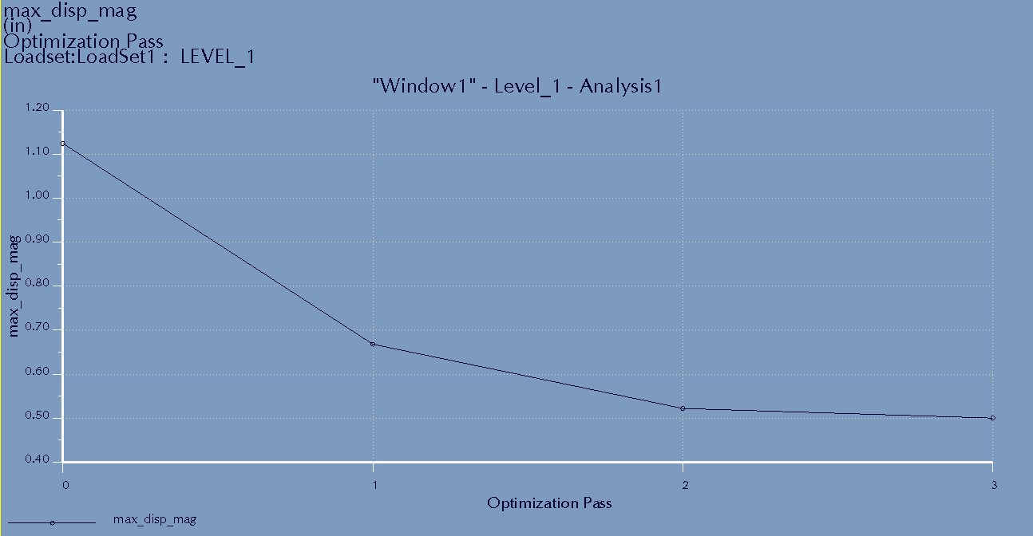
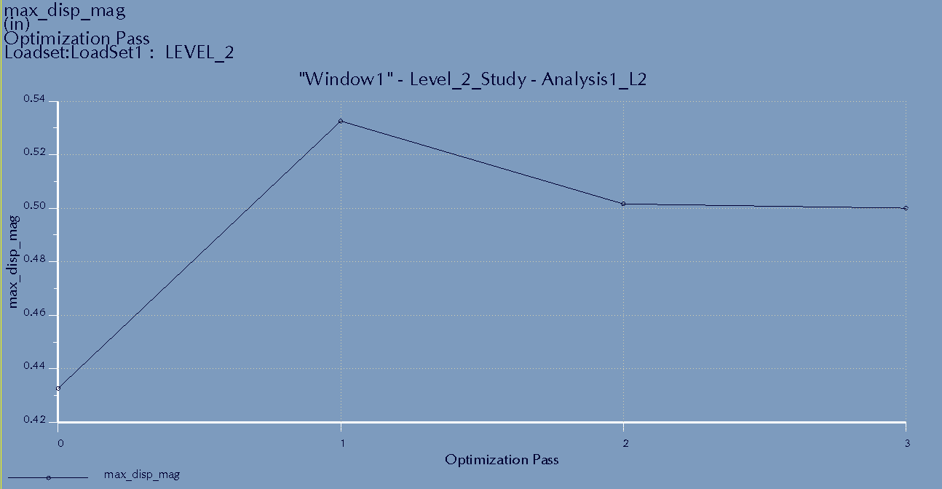
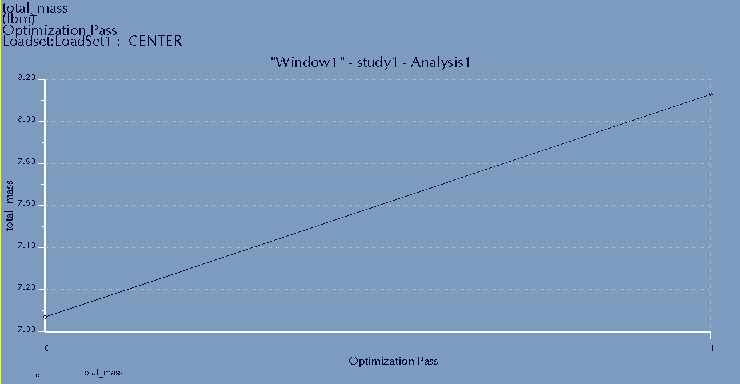
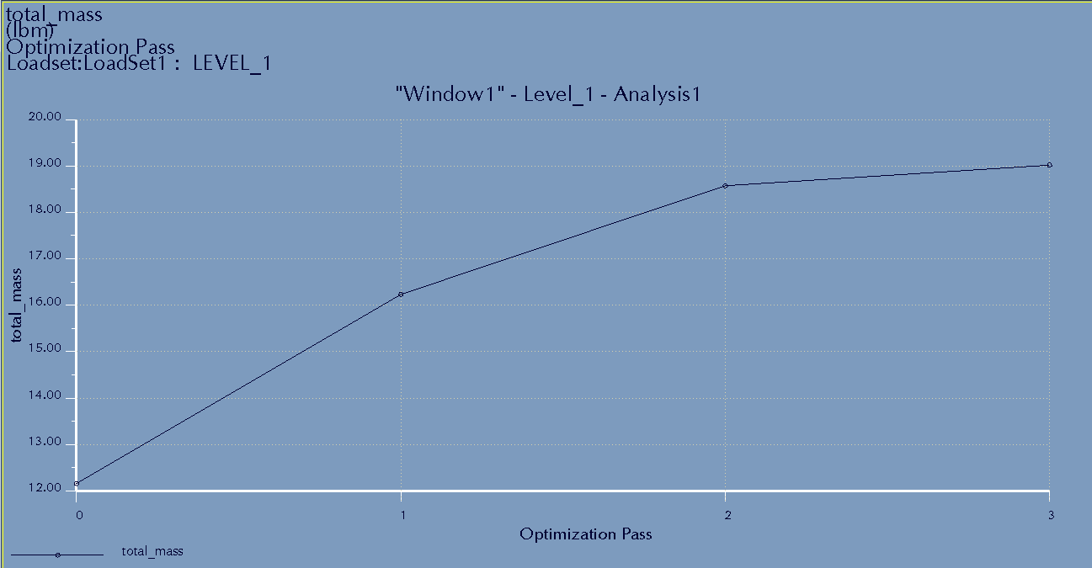
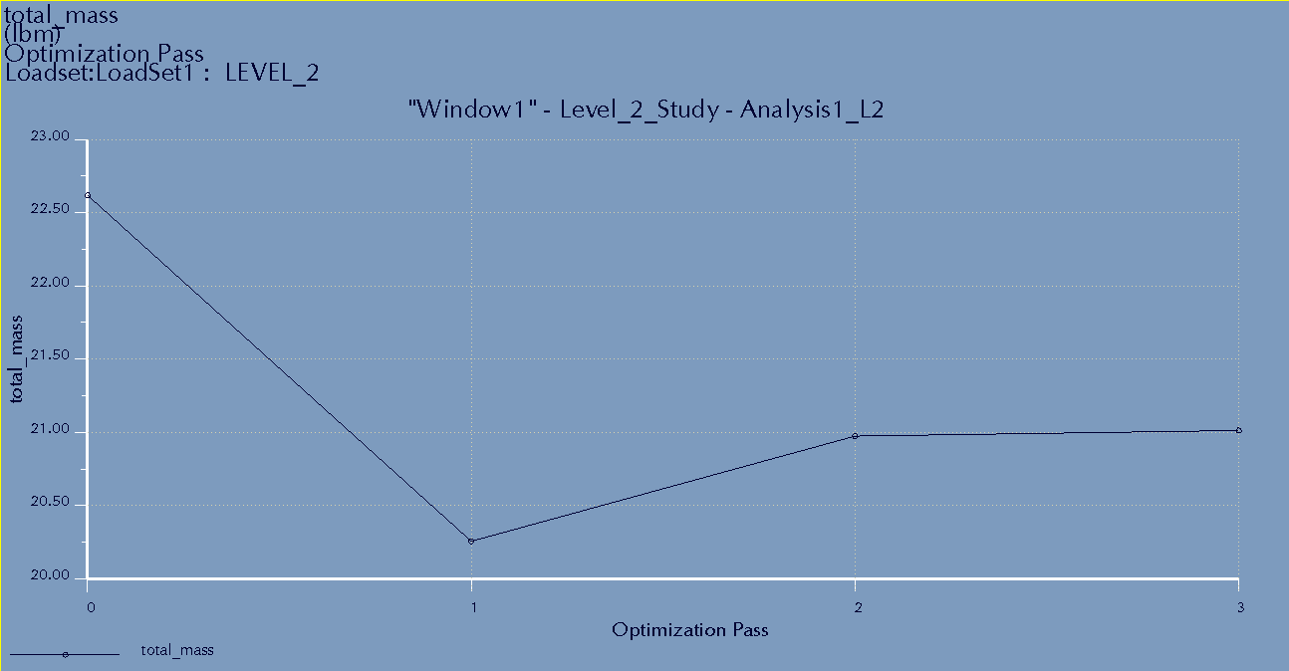
Convergence– Static Pressure Load
Center
Level 1
Level 2
Displacement (Top)
Mass (Bottom)

Slide 11
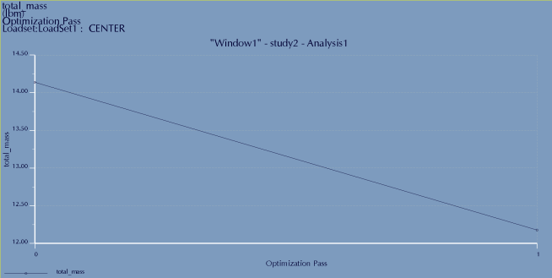
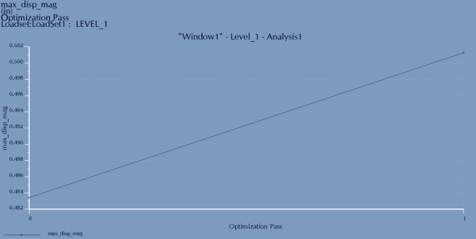
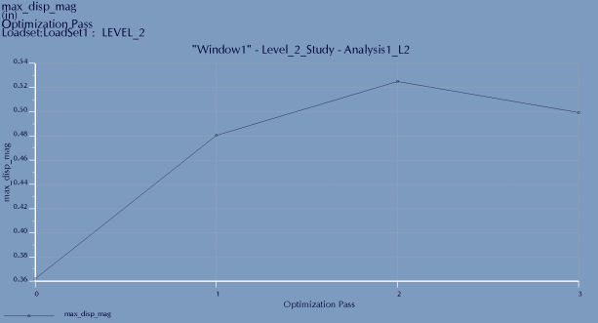
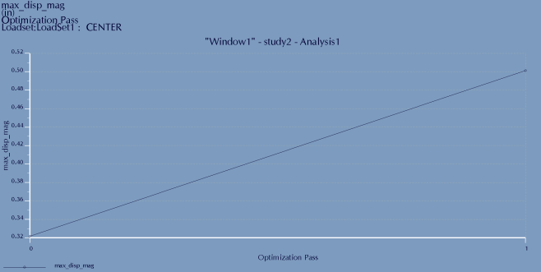
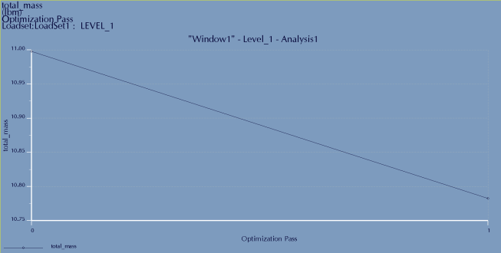
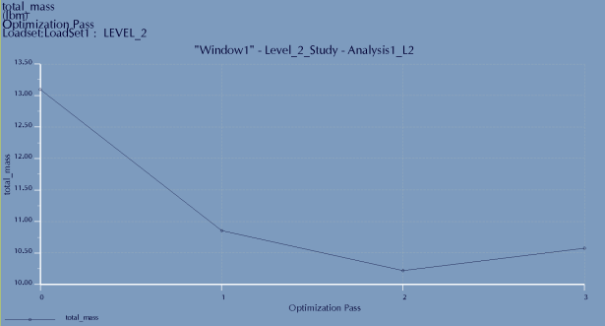
Convergence– Sinusoidal Pressure Load
Center
Level 1
Level 2
Displacement (Top)
Mass (Bottom)

Slide 12
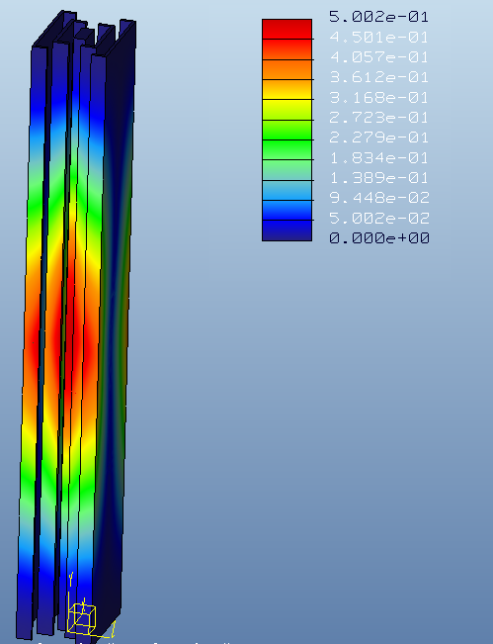
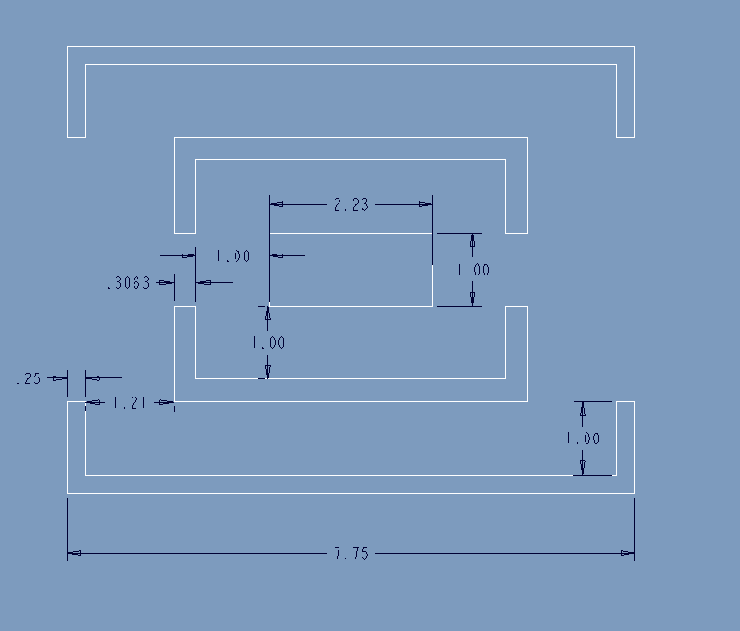
Results– Bullet Load
Mass: 159.3 lbm

Slide 13
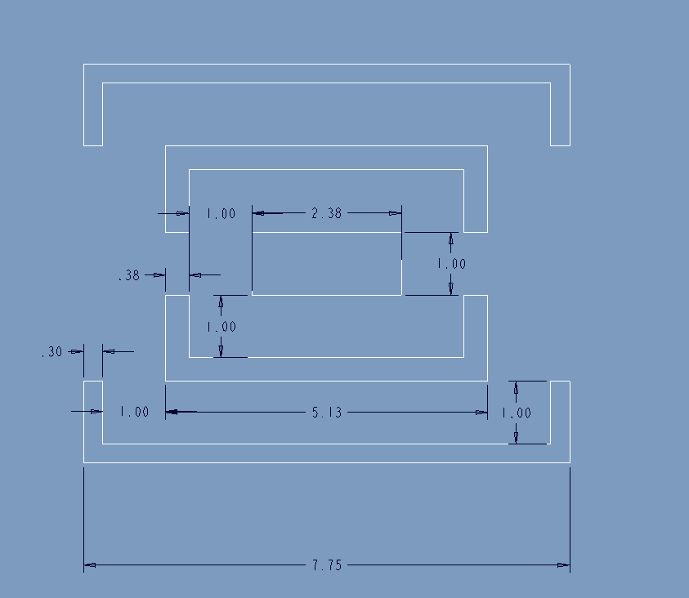
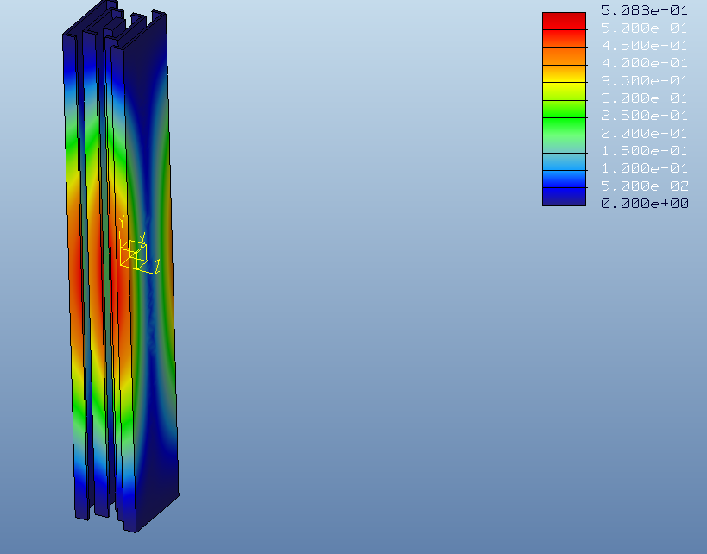
Results– Static Pressure Load
Mass: 193.7 lbm

Slide 14
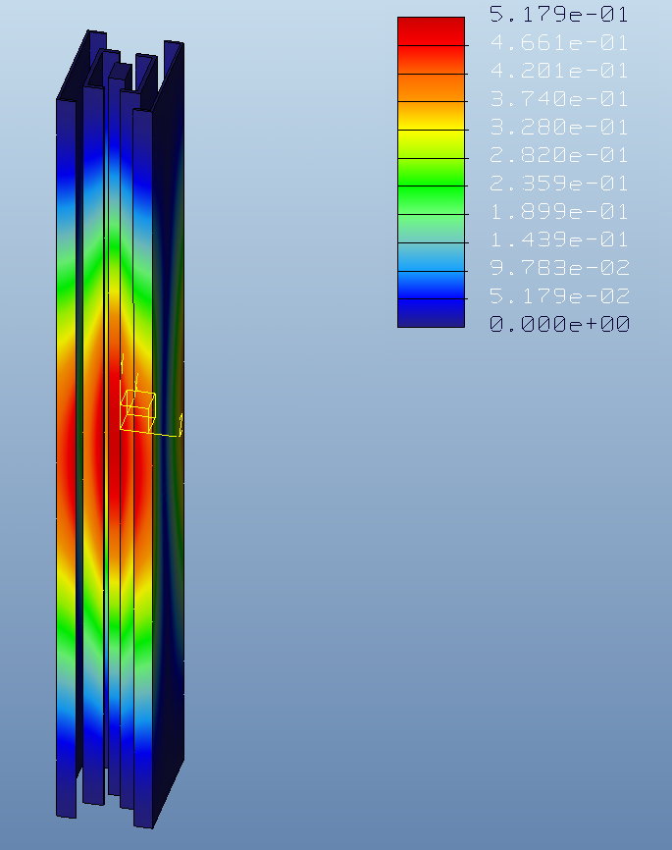
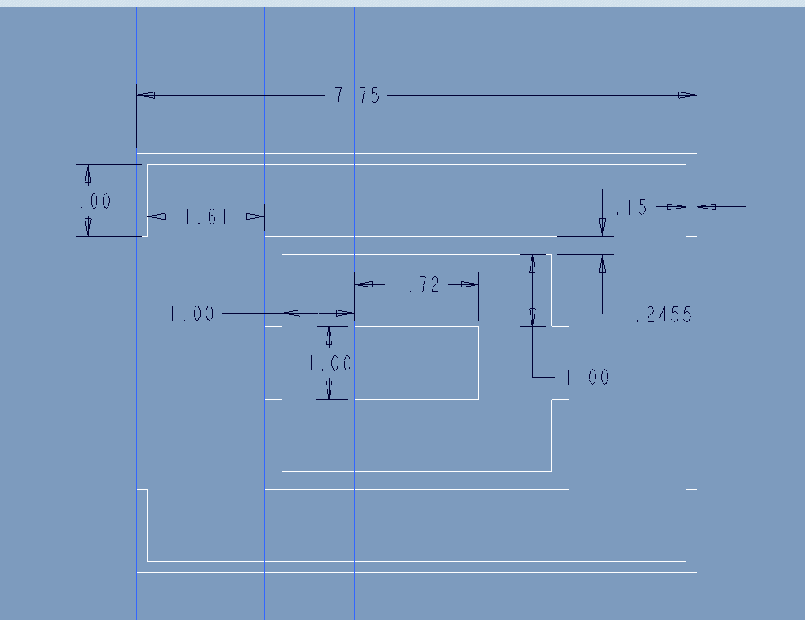
Results– Sinusoidal Pressure Load
Mass: 109.8 lbm

Slide 15
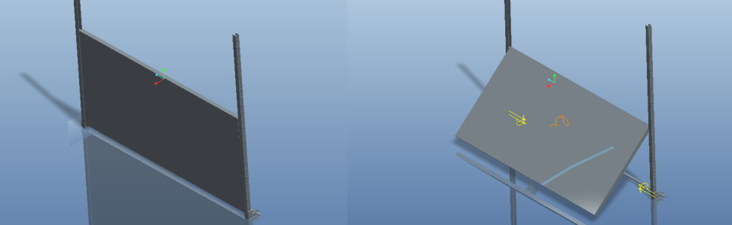
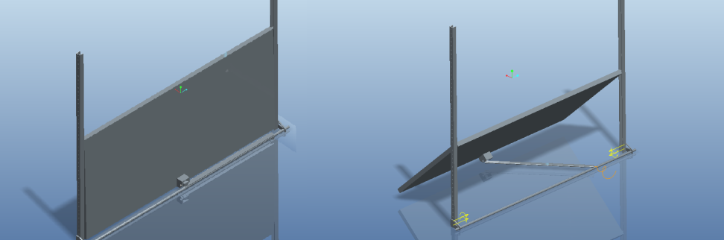
Storm Shutter Overview
25” tall to minimize amount needed to completely cover louvers
50” wide to cover multiple louvers at once
Uses threaded rod to control linear actuation

Slide 16
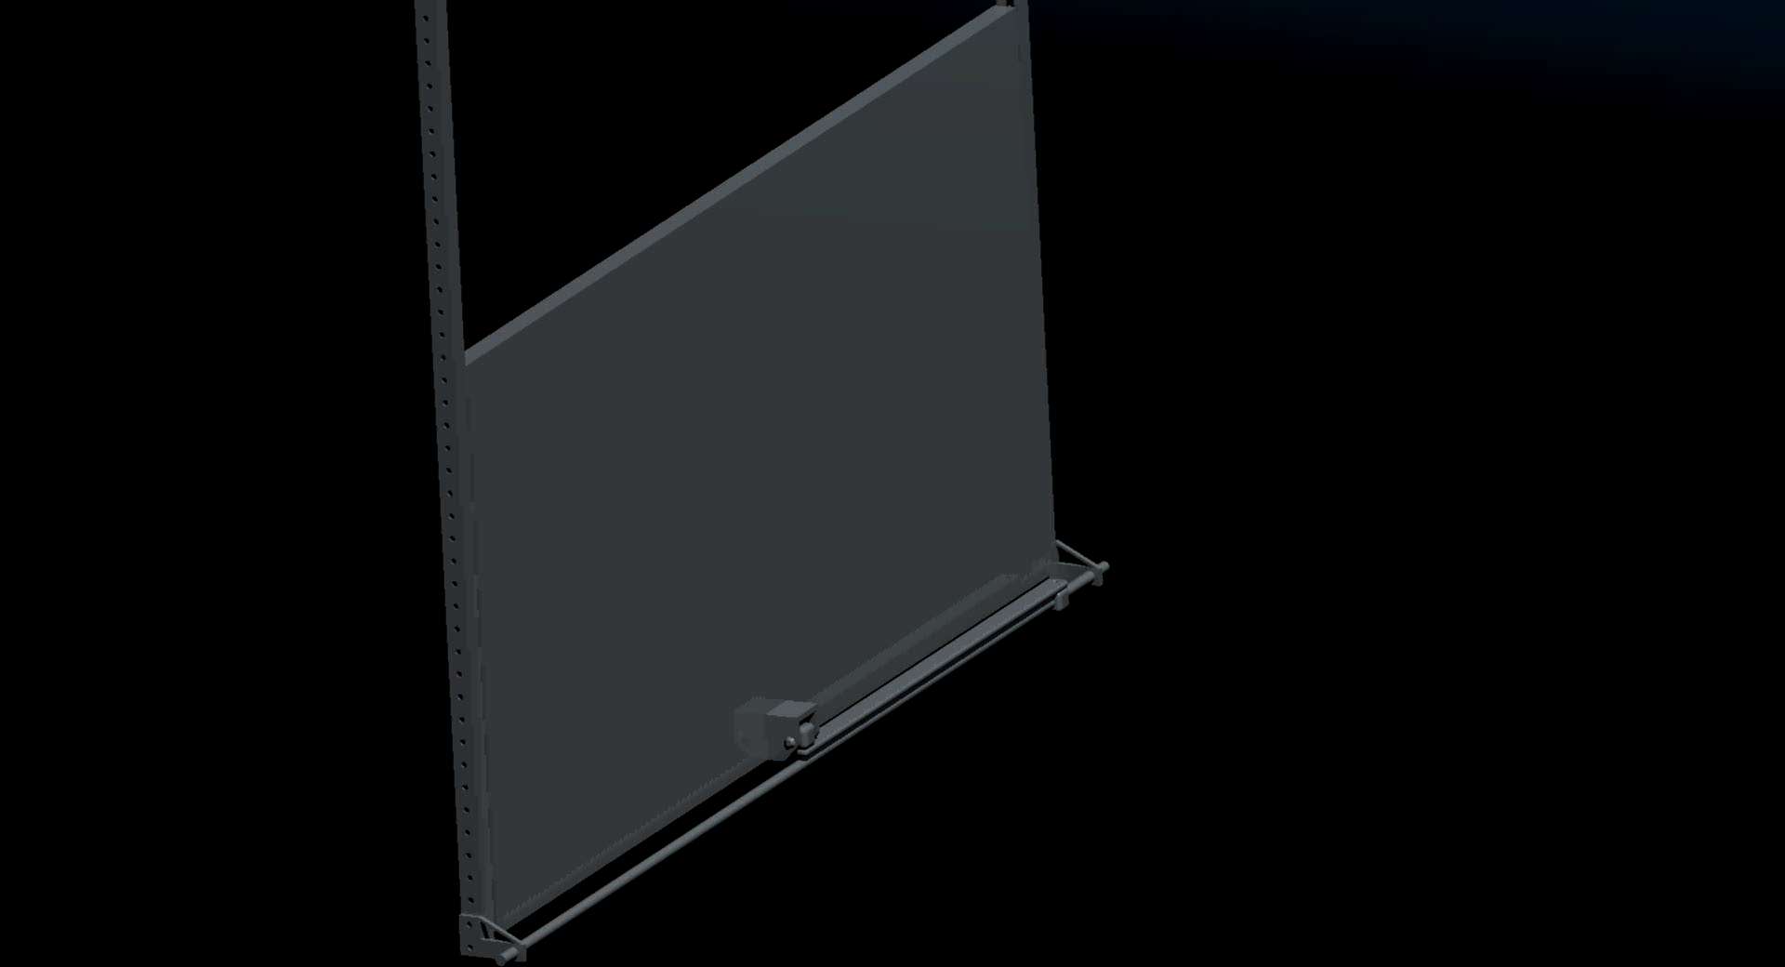
Storm Shutter– Interior

Slide 17
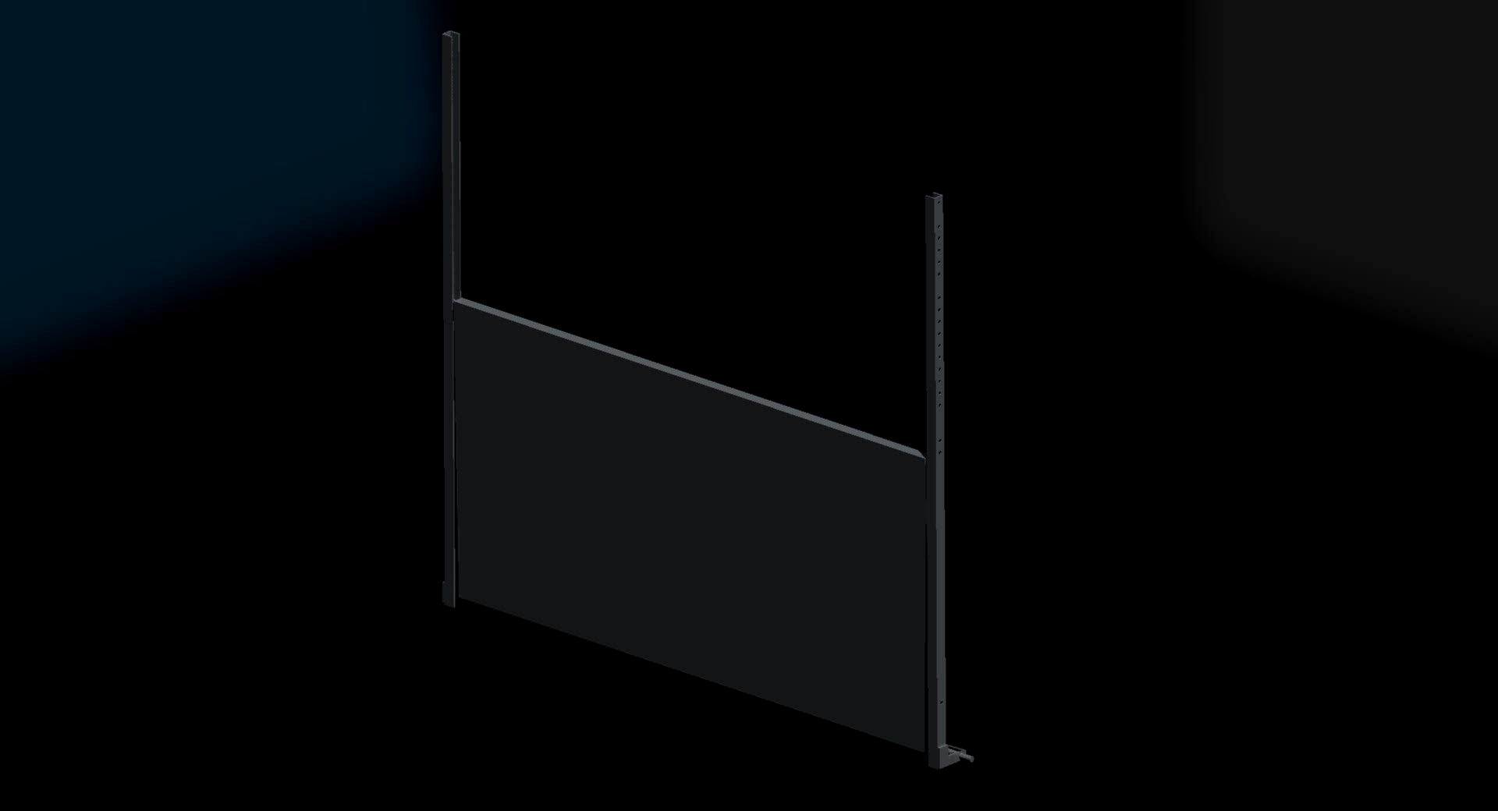
Storm Shutter– Exterior

Slide 18
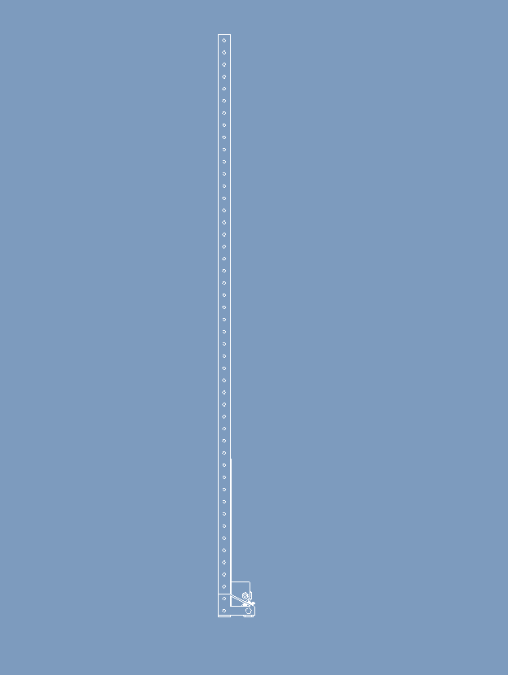
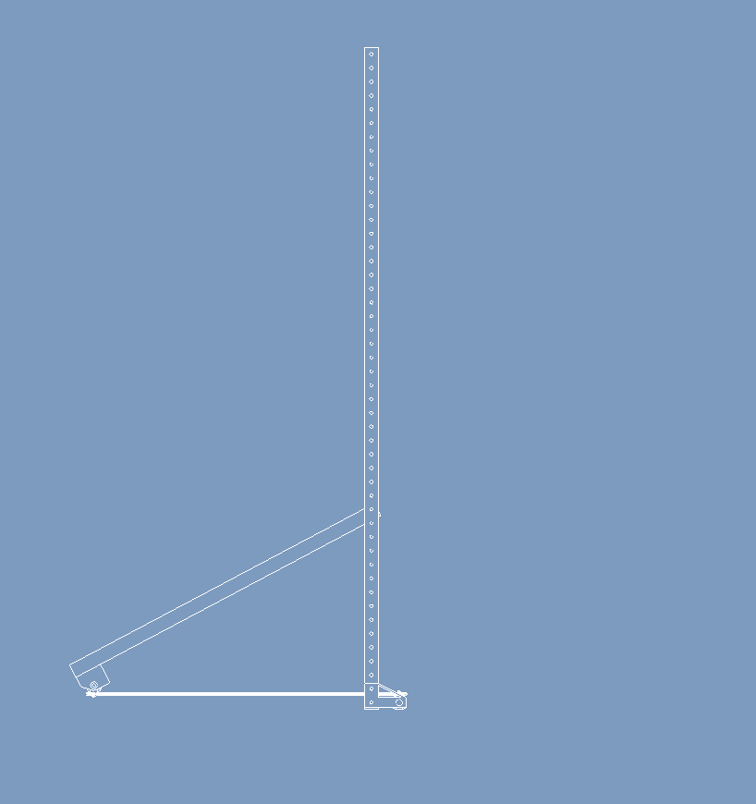
Storm Shutter– Design Features
Easily fits in 6” space allotted
Minimal occlusion when open
Easily scaled in both directions
Can control many shutters with one motor
Easy to install with pre-existing louvers
Can customize width of shutter easily

Slide 19
Conclusions
Further analyses must be performed to determine optimal design
Threat analysis
Non-linear deformations
Air flow
Cost/assembly feasibility
Good initial analysis for FEBR louver optimization
1000-psi static force appears to be the most rigorous
Associated shutter works to keep water out
Won’t open in high winds
Force Method | Mass (lbm)
Bullet | 159.3
1000-psi Static Force | 193.7
1000-psi Sinusoidal Force | 109.8

Slide 20
Thank you Any questions or comments?

